Slide 1
Timeline
DATE | TOPICS | RELATED TOPIC
23/6/2025 – 27/6/2025 | Setting up the development environment (Visual Studio, CUDA Toolkit, OpenCV, and other dependencies). Run the xvtCudaBatteryExample Calculate the maximum outer of lower part of the battery

Slide 2
BATTERY INSPECTION PROJECT

Slide 3
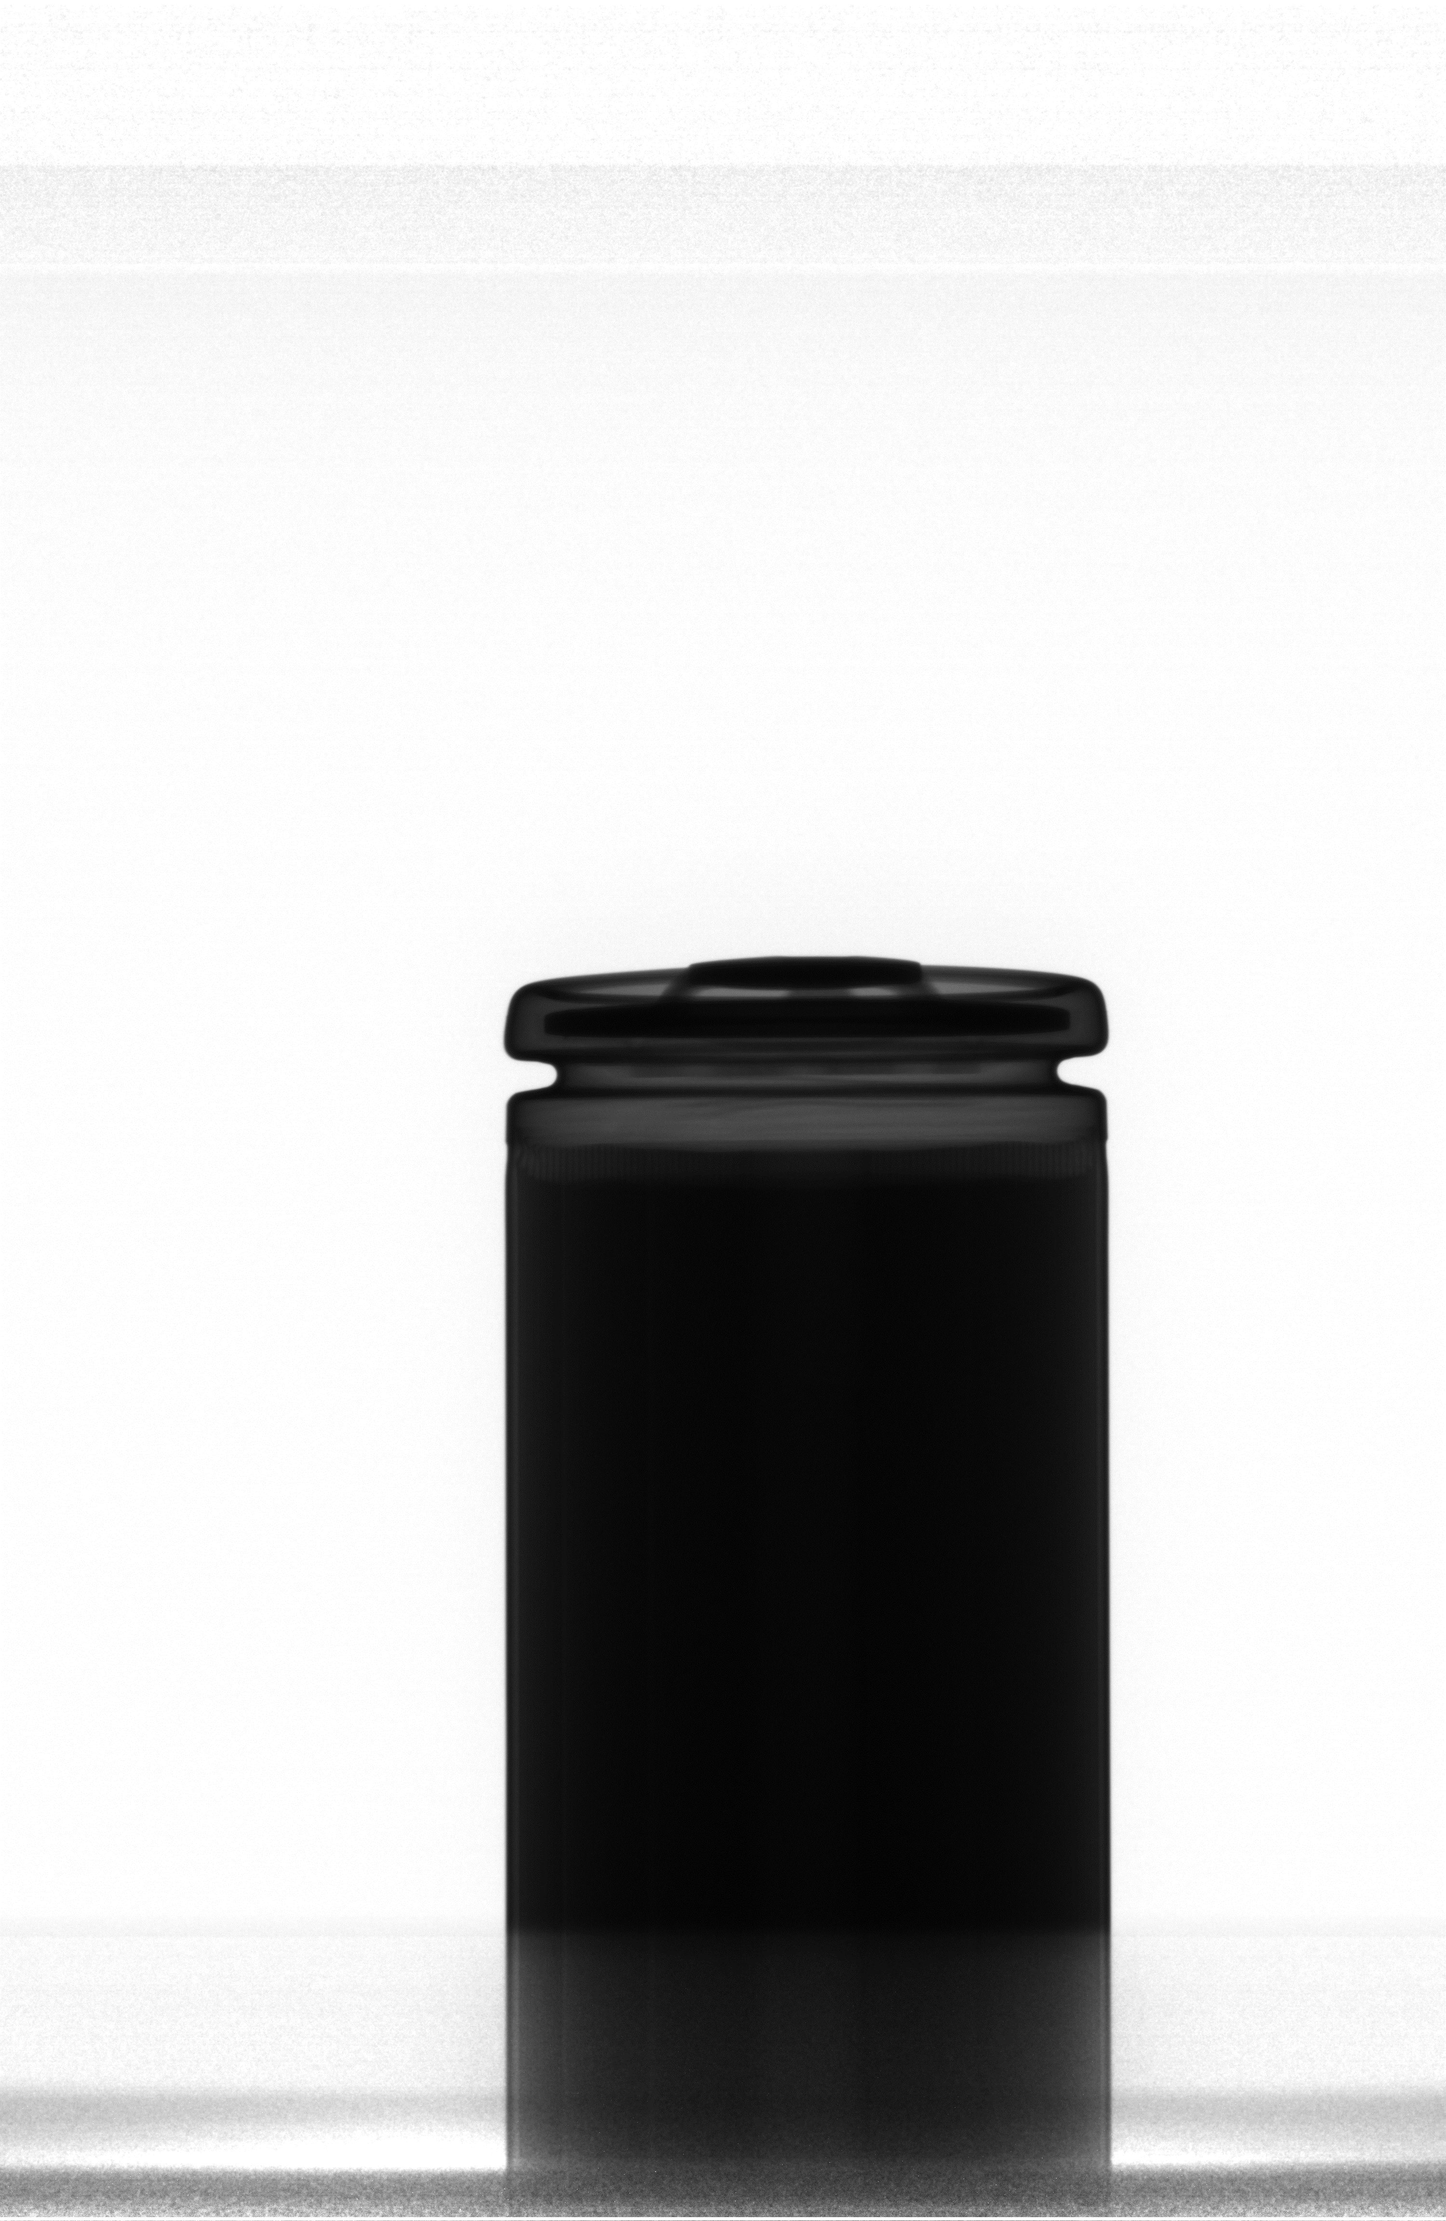
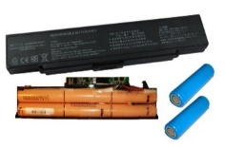
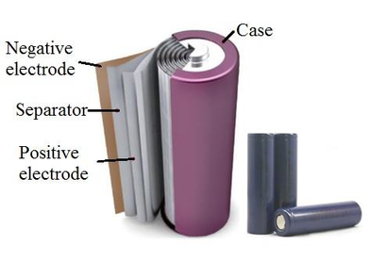
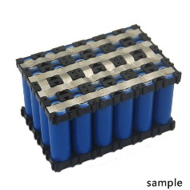
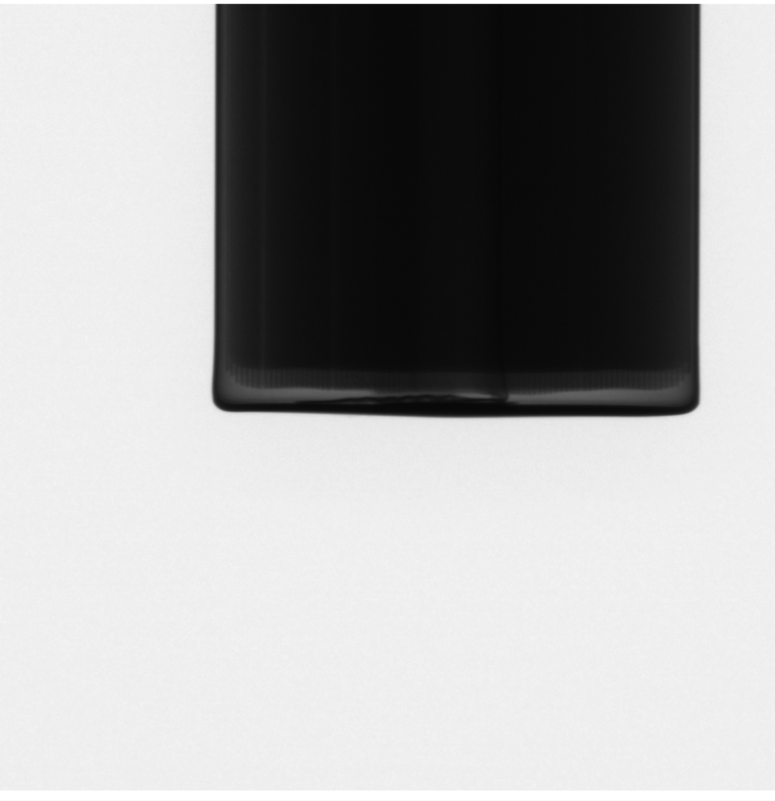
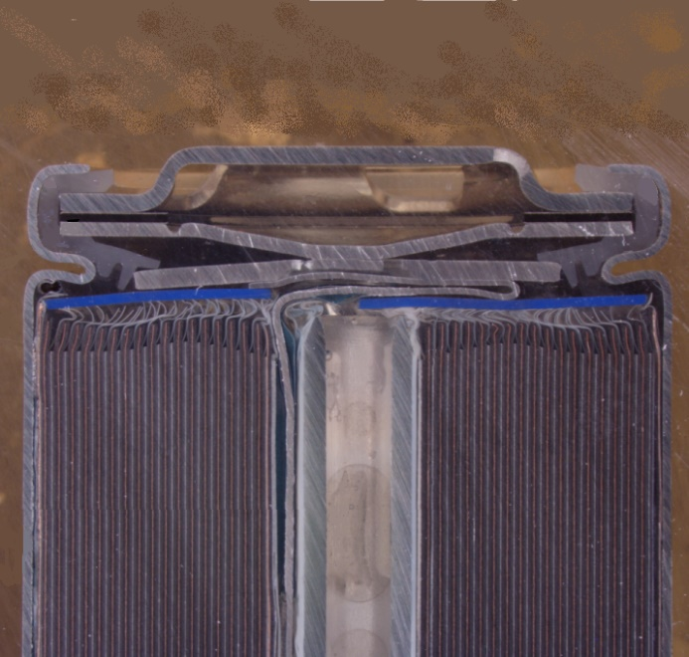
Battery inspection project
Cylinder battery
Xray-machine
Image Source: Murashko, Kirill. "Thermal modelling of commercial lithium-ion batteries." (2016).
Sample image (upper)
Separator (Jelly-Roll)
Negative pole
Positive pole
Sample image (lower)

Slide 4
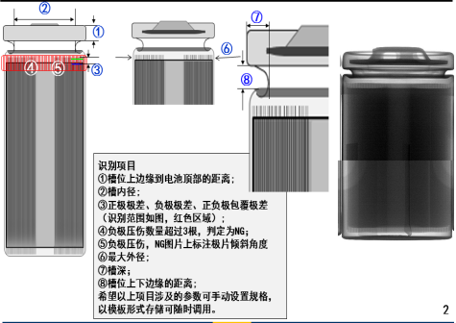
Goal of detection
Inspection Item:
① : Thickness of top cover
② : The inner diameter of the plant
③ : Distance between negative pole and positive pole.
④ : Number of NG negative pole (bent or tilted).
⑤ : Inclination angle of tilted poles.
⑥ : Maximum outer diameter
⑦ : The depth of the groove
⑧ : Distance between upper and lower edges.
Target:
Accurately measure internal linear distances between poles and Identify misaligned components
Challenge:
Input images have poor contrast
Shadow effect cause by Jelly Roll (separator)
Tab interference (in lower part)

Slide 5
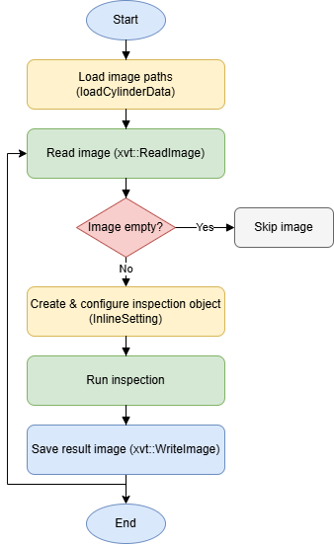
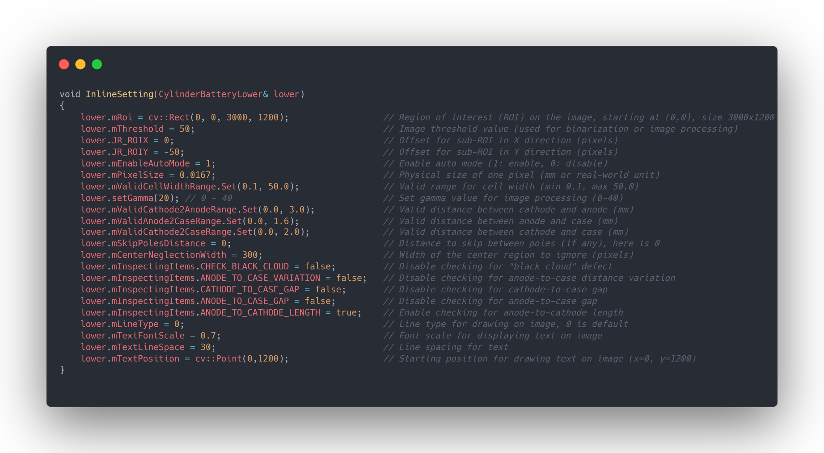
xvtBatteryExample to inspect Lower part

Slide 6
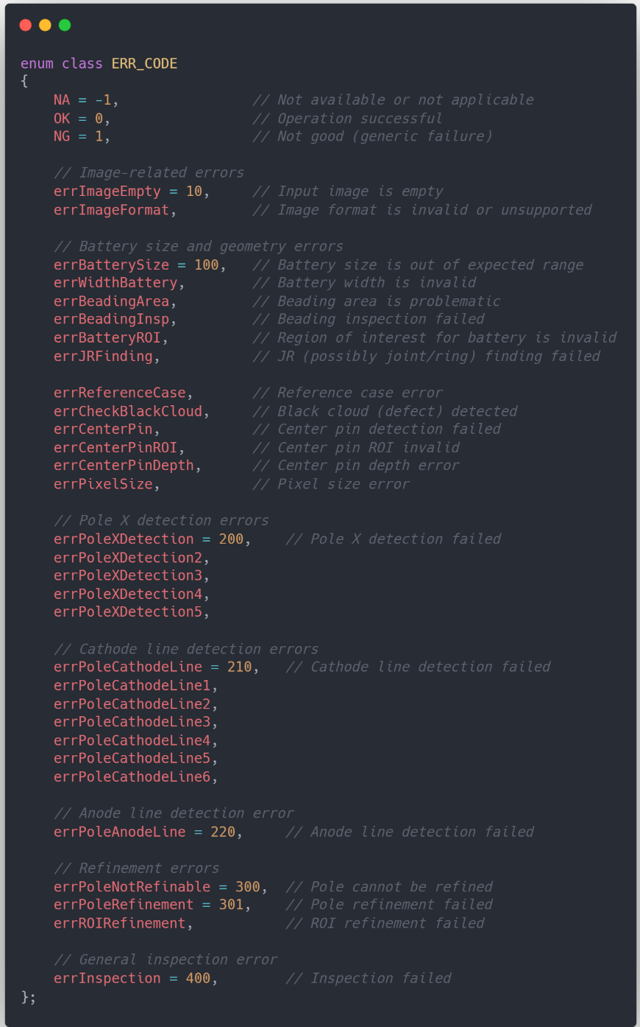
Error code

Slide 7
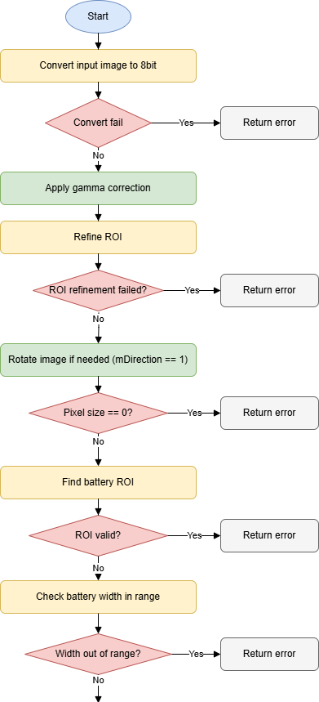
Inspection → Inspection2
Contrast enhancement
Preprocessing
Adjusts a selected ROI (Region of Interest) to ensure it remains inside an image.
Standardize the inspection process for both the lower and upper parts

Slide 8
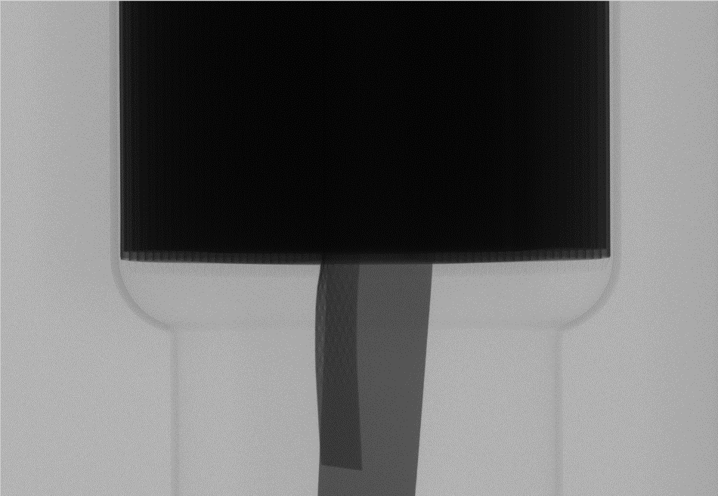
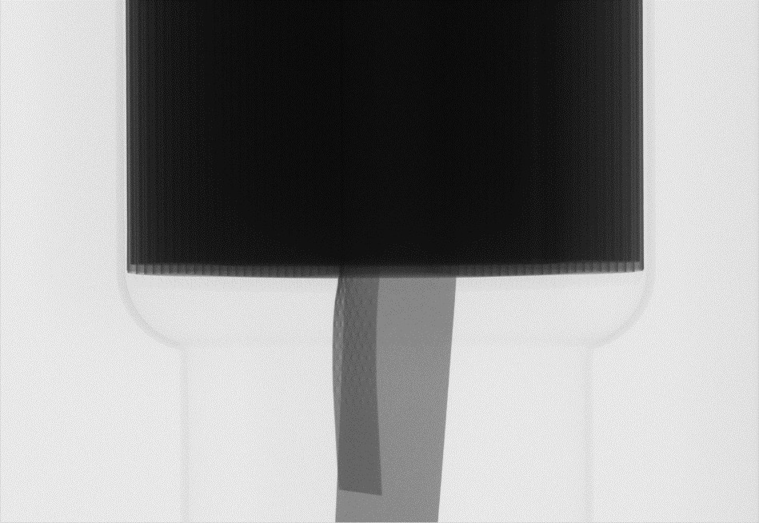
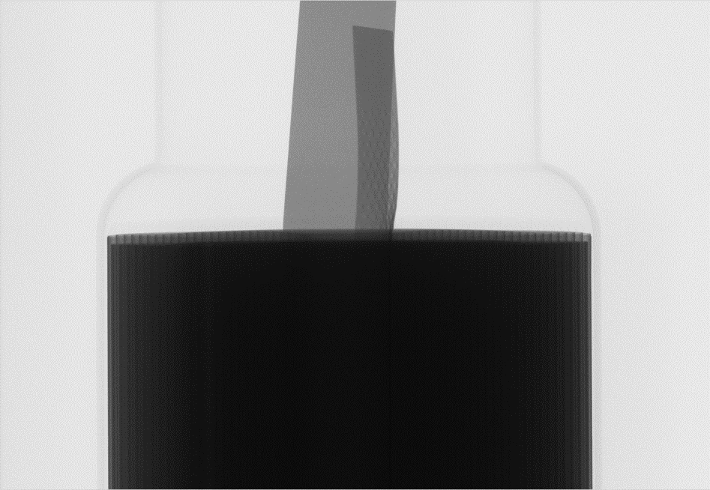
Inspection2
Apply gamma correction
Rotage image

Slide 9
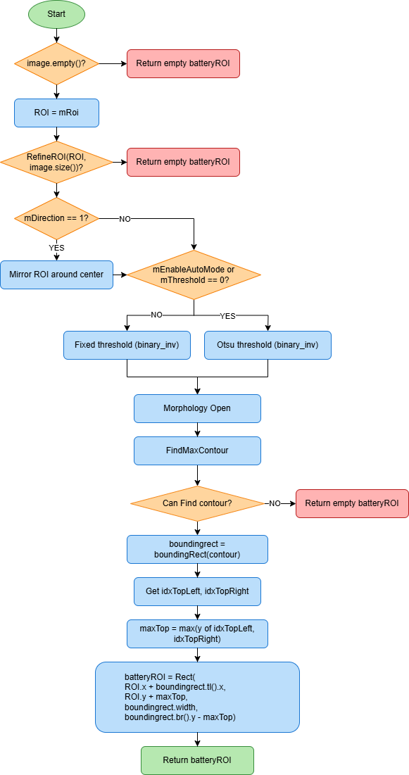
Find battery ROI

Slide 10

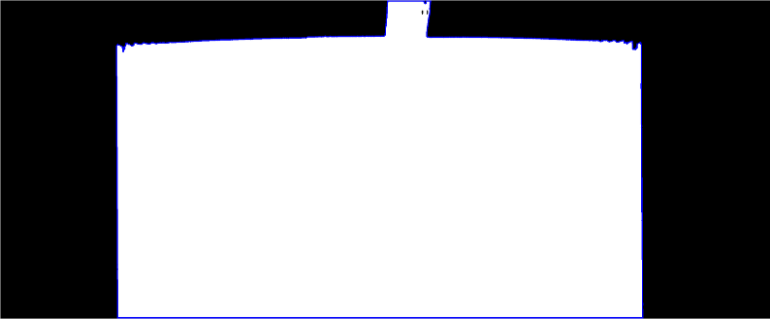

Find battery ROI
Image before rotation
ROI
Image after rotation
Mirror ROI around center
FindMaxContour
Threshold
Image(ROI)

Slide 11
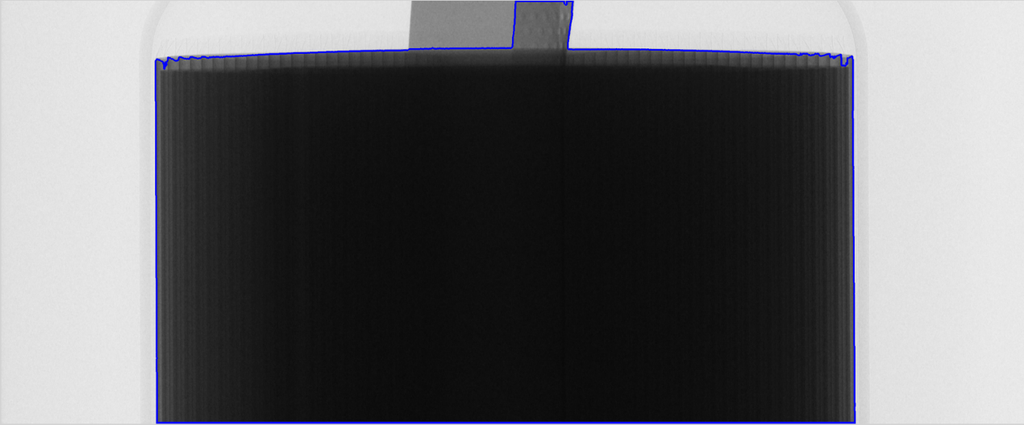
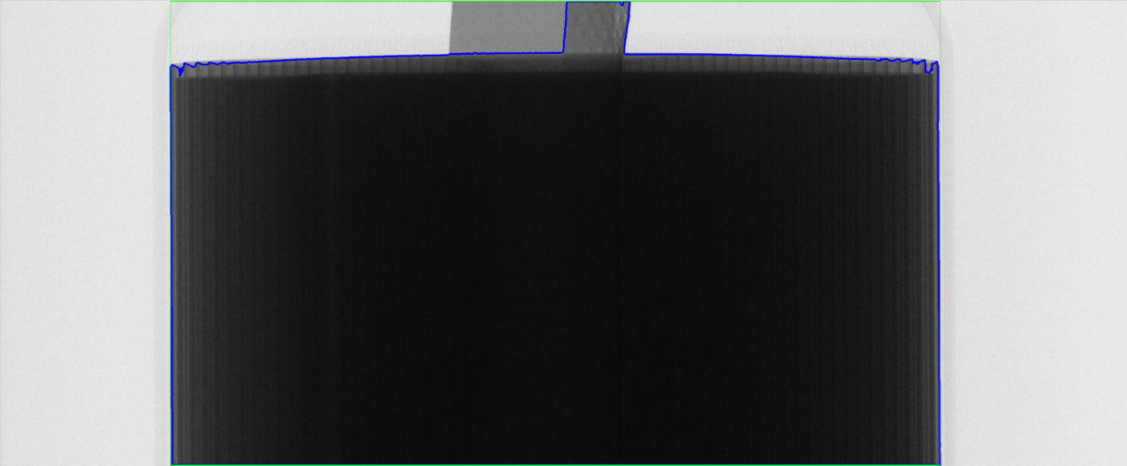

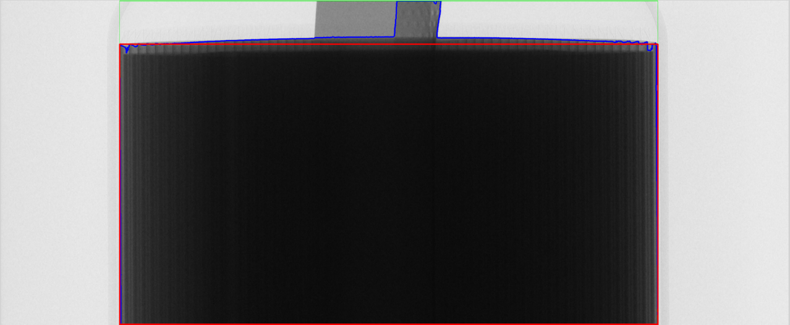
Find battery ROI
Top-Left
Top-Right
boundingRect(contour)
Battery ROI
Battery ROI
Top-Left
Top-Right

Slide 12
Check pole leaning
Pole Leaning detected position
Center of battery case
"Pole Leaning Position” is the specific location in the image of the battery case where the poles are identified as leaning or deviating from their ideal positions.
d
d
After finding the Pole Leaning position, we can adjust the affective range (battery center/neglect region) to the new value.
Neglect Center region
Affective range

Slide 13
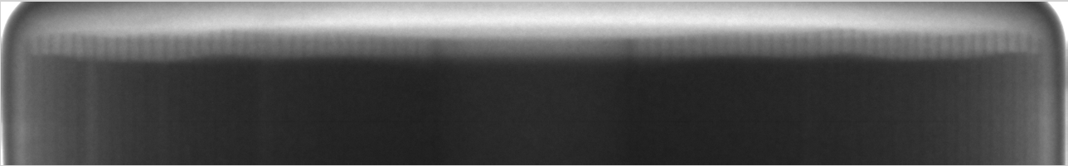
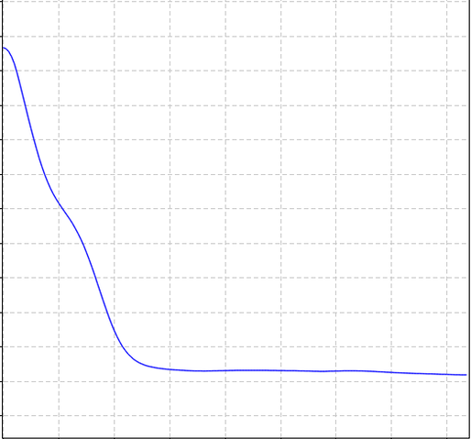
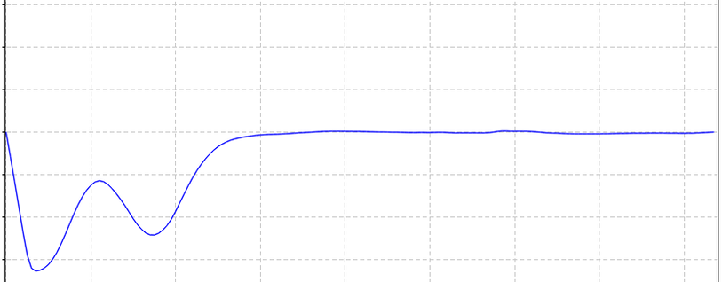
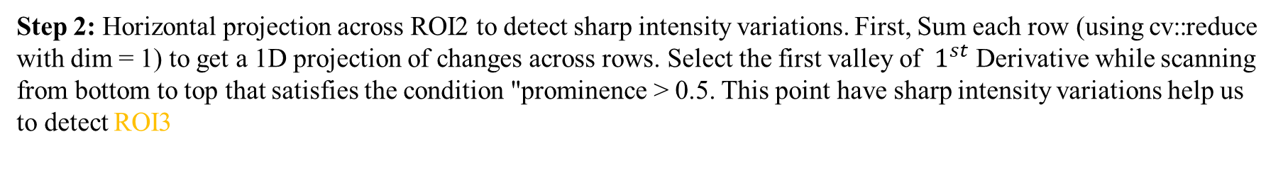
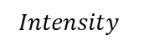
Find pole leaning (Auto)
ROI1
ROI2
ROI3
$1^{st}$ Derivative
$$Intensity$$
Step 1: Define ROI1 and ROI2 based on the specifications provided in Tables 1 and 2, respectively.
Padding = battery width * 0.012
ROI1
x1 | batteryROI.x
y1 | A2.y + JR ROI Y
width1 | batteryROI.width
height1 | Pole region height
ROI2
x2 | x1 + padding
y2 | y1 + 2*padding
width2 | width1 – 2*padding
height2 | height1 – y2
Step 2: Horizontal projection across ROI2 to detect sharp intensity variations. First, Sum each row (using cv::reduce with dim = 1) to get a 1D projection of changes across rows. Select the first valley of ${ 1}^{st}$ Derivative while scanning from bottom to top that satisfies the condition "prominence > 0.5. This point have sharp intensity variations help us to detect ROI3

Slide 14
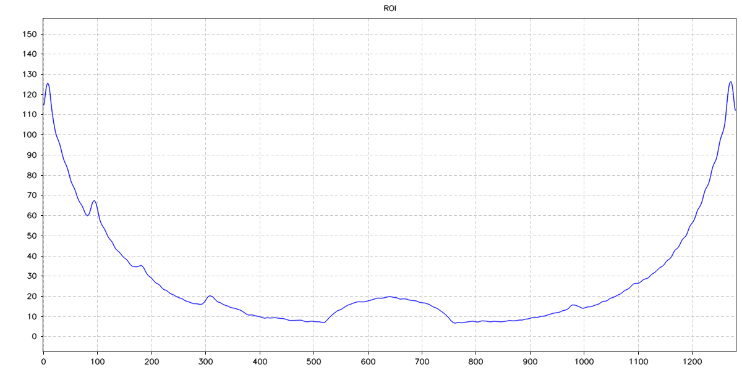
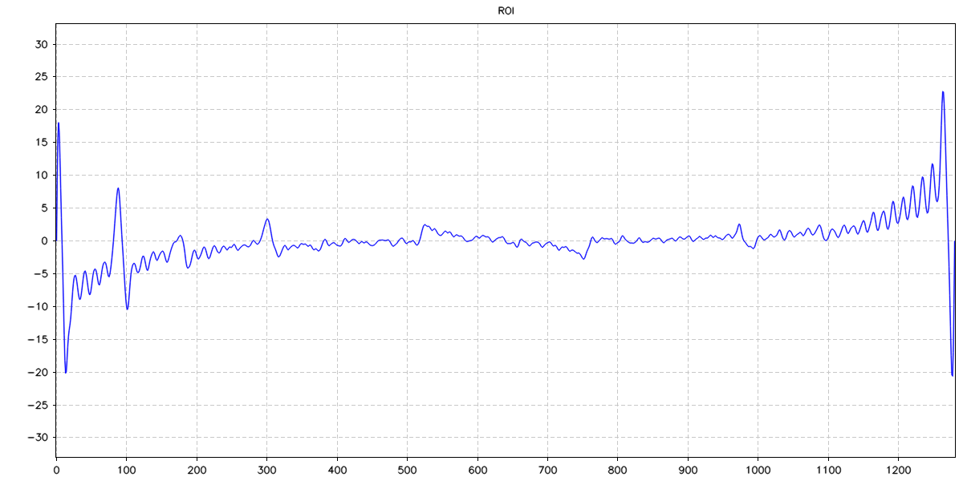

ROI2
ROI3
limLeft
limRight
Vertical projection of ROI3
Peak (Leaning position)
$1^{st}$ Derivative
15
-15
Valley(leaning position)
Step 3: Divide the entire image into twelve equal sections. Determine the leftmost and rightmost boundaries for each section (typically visualized as red dashed lines).
Step 4: Check condition leaning:
On the left side: valley is leaning line (index < limLeft && value < -15)
On the right side: peak is leaning line (index > limRight && value > 15)

Slide 15
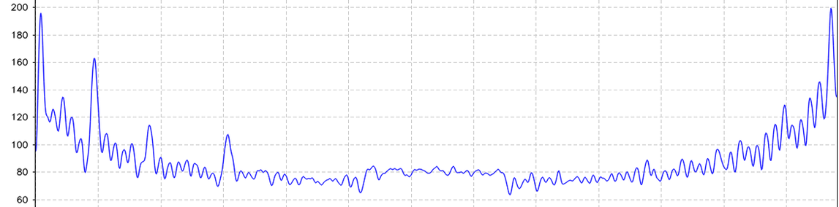
Find pole leaning (Manual)
ROI1
Step 1: Define ROI1 and ROI2 based on the specifications provided in Tables 1 and 2, respectively.
ROI2
ROI3
Padding = battery width * 0.012
ROI1
x1 | batteryROI.x
y1 | A2.y + JR ROI Y
width1 | batteryROI.width
height1 | Pole region height
ROI2
x2 | x1 + padding
y2 | y1 + 2*padding
width2 | width1 – 2*padding
height2 | height1 – y2
LimLeft
LimRight
ROI3
Leaning position
Leaning position
Thd
Step 2: Apply CLAHE (Contrast Limited Adaptive Histogram Equalization) to the refined ROI3. Subsequently, perform vertical projection on the processed ROI3 to extract relevant information.
Vertical projection of ROI3
Step 3: Divide the refined ROI3 into twelve sections of equal size.
Step 4: Check condition leaning:
Left leaning: Intensity previous column > thd & Intensity next column < thd
Right leaning: Intensity previous column < thd & Intensity next column > thd

Slide 16
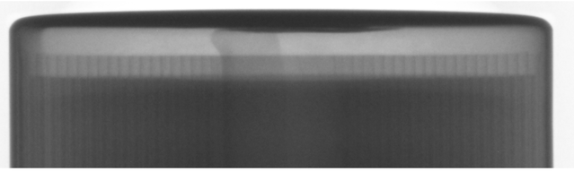
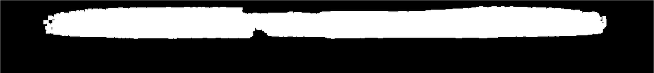

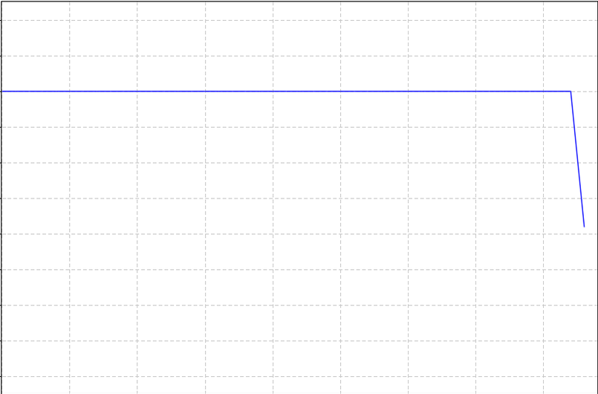
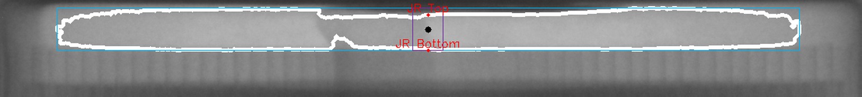
Finding J/R position
ROI1
ROI4
ROI5
Step 1: Define ROI4 and ROI5 based on ROI1 and the "leaning" position information.
ROI4
x4 | ROI1.x + leaning
y4 | ROI1.y
width4 | ROI1.width – 2 * leaning
height4 | ROI1.height
ROI5
x5 | x4 + JR ROI X
y5 | y4
width5 | width4 – 2 * JR ROI X
height5 | height4
Step 2: Apply the multilevel Otsu thresholding method to ROI5 to determine an optimal threshold value. Utilize this threshold to create a binary image from ROI5.
Step 3: Identify contours within the binary image. Locate the largest contour to create ROI6 and employ moment analysis to calculate its center coordinates.
Step 4: Create ROI7 centered on the previously identified contour center with a window size of 40 pixels.
Step 5: Perform horizontal projection on ROI7. Identify the position where the projected value falls below half the window size 20. Additionally, locate the position with a projected value of zero (0).
JR Top
JR Bottom
JR Top
center
wdSize
window size
wdSize/2
JR Bottom
y-Axis
y-Axis
ROI7
ROI6

Slide 17
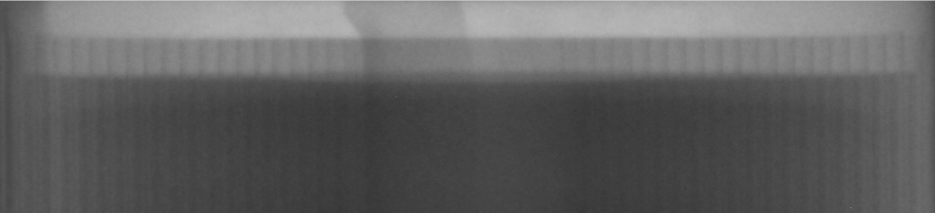
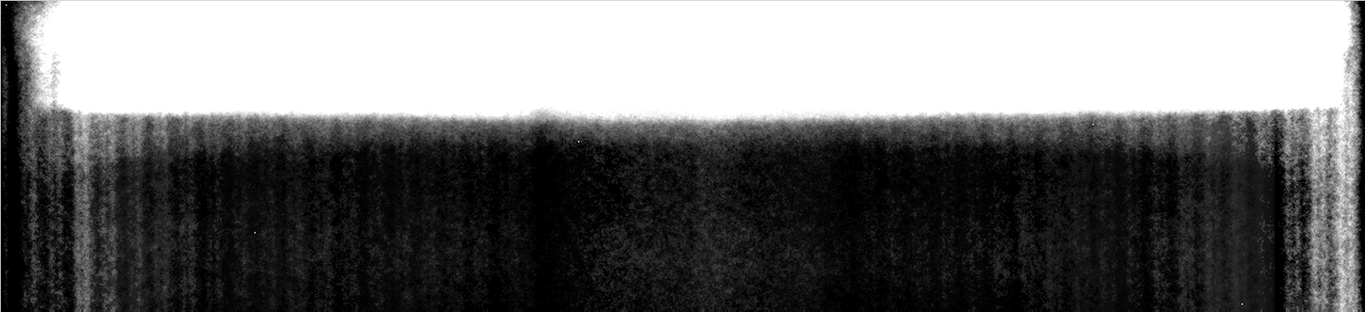
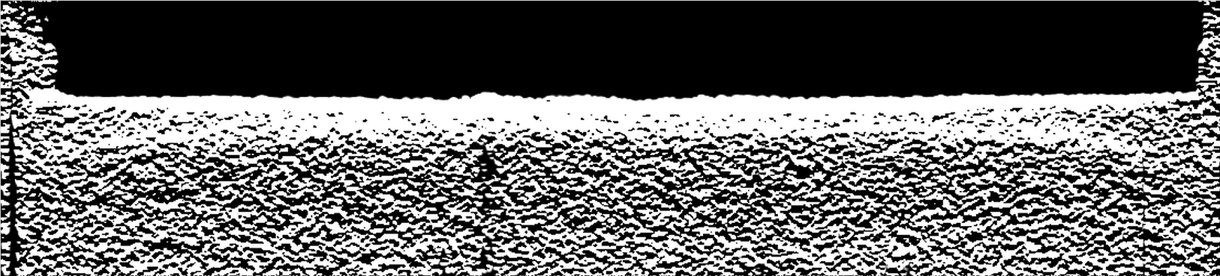
Finding Cathode Line Position (Auto - Dijkstra-like algorithm)
Step 1: Applies local histogram equalization to the input image to enhance local contrast, making the cathode line more distinguishable.
Step 2: Applies a diagonal filter (custom edge enhancement) to the locally enhanced image to further highlight the cathode line.
Step 3: Calculates the start and end columns of the "center neglection area" (a region in the center of the image to be ignored, often because the center is not relevant or is noisy).
Step 4: Split Image into Left and Right Regions
Step 5: For each side, runs a Dijkstra-like algorithm to find the optimal path (the cathode line) from left to right and right to left.
Step 6: Merge Results
neglect

Slide 18
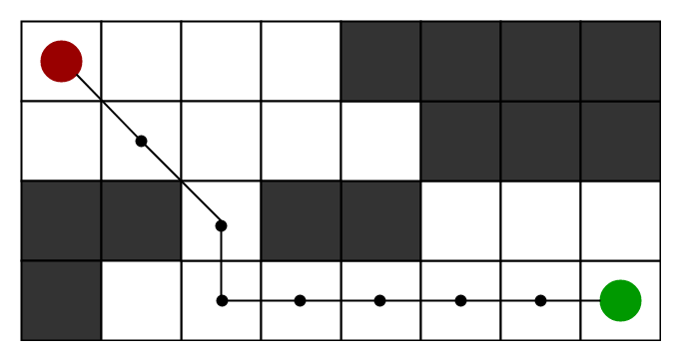


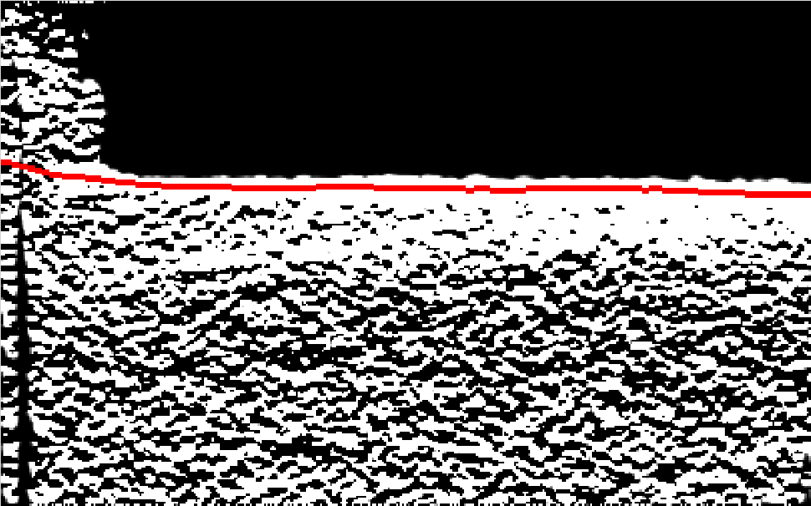
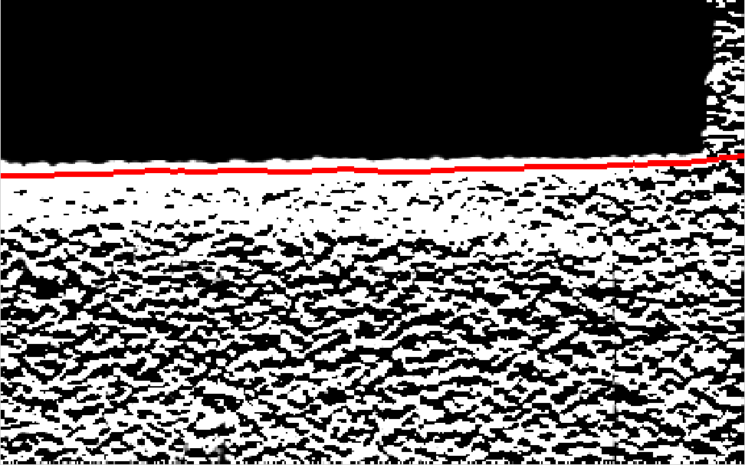
A* algorithm
Step 1: Dynamic Programming Accumulation:
Look at the three possible positions in the previous column: directly above, same row, and directly below. Add the maximum value among these three to the current pixel. This accumulates the "best path" score to each pixel, favoring strong, continuous features.
Step 2: Traceback: Find the Best Path
Find the row with the maximum accumulated value in the last column (the end of the best path). Store this row index in vtLine for the last column.
For each previous column (right to left): In a window around the previous best row, find the row with the maximum value. If the maximum is not just the mean value (i.e., it's a real feature), use its index; otherwise, repeat the previous row.
neglect

Slide 20
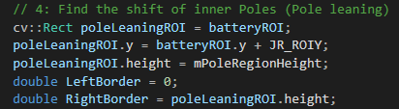
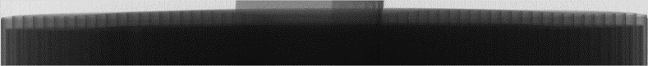
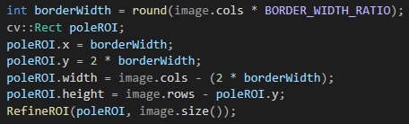
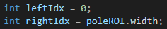
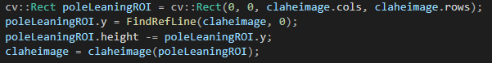
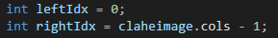

Slide 21



Slide 22
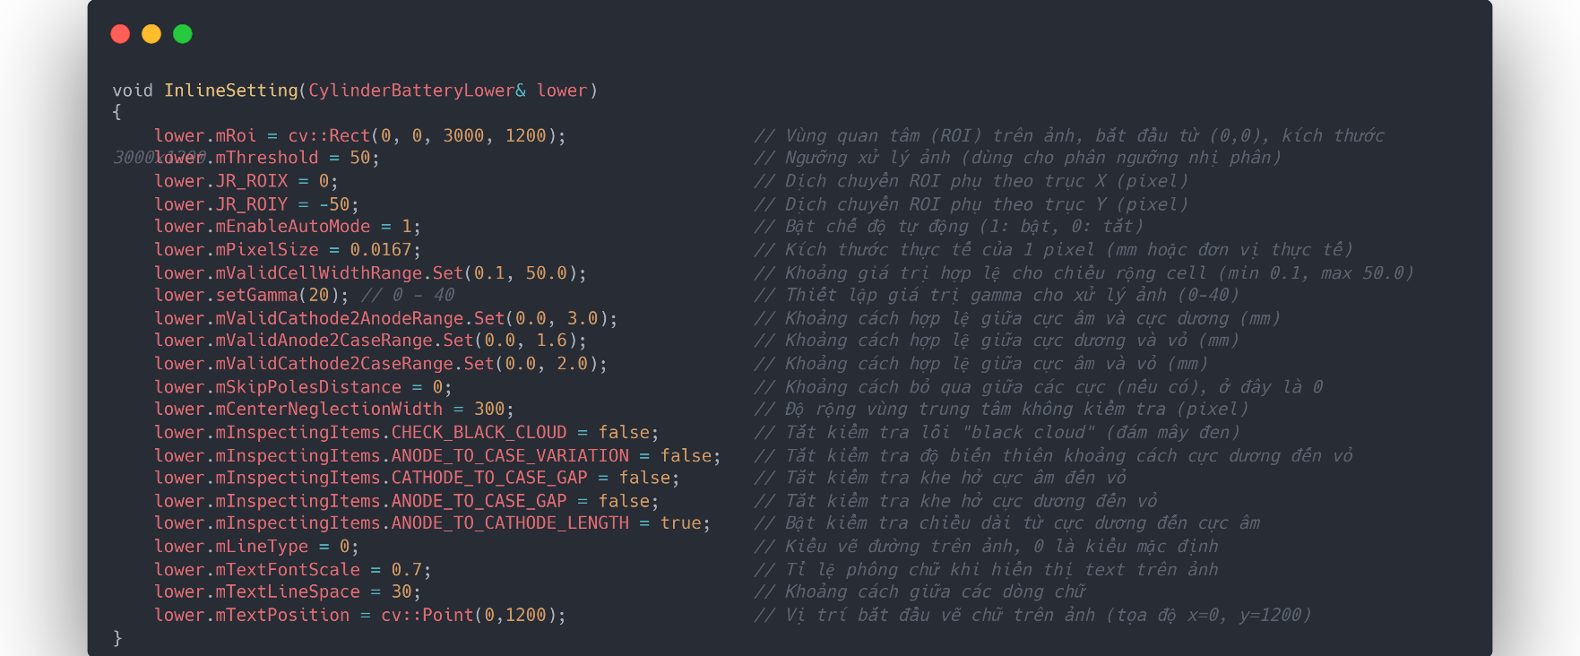

Slide 23
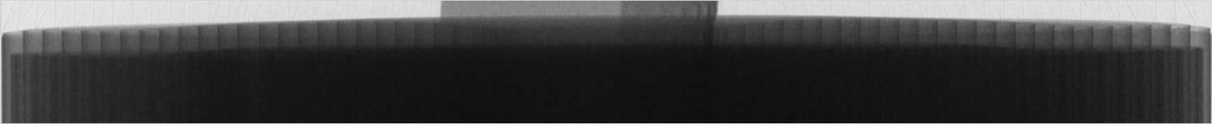

Slide 24
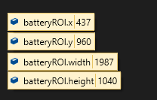
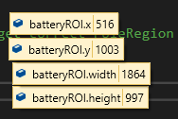

Slide 25
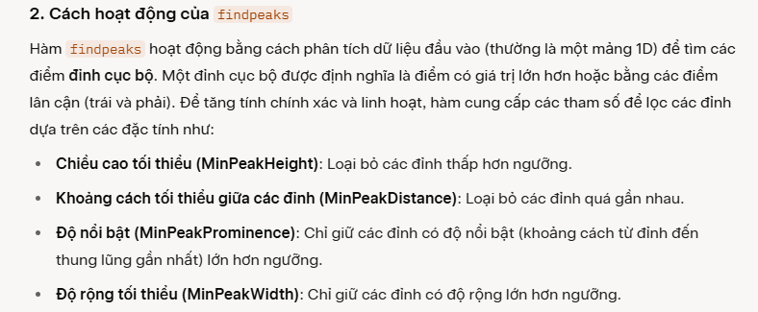

Slide 26
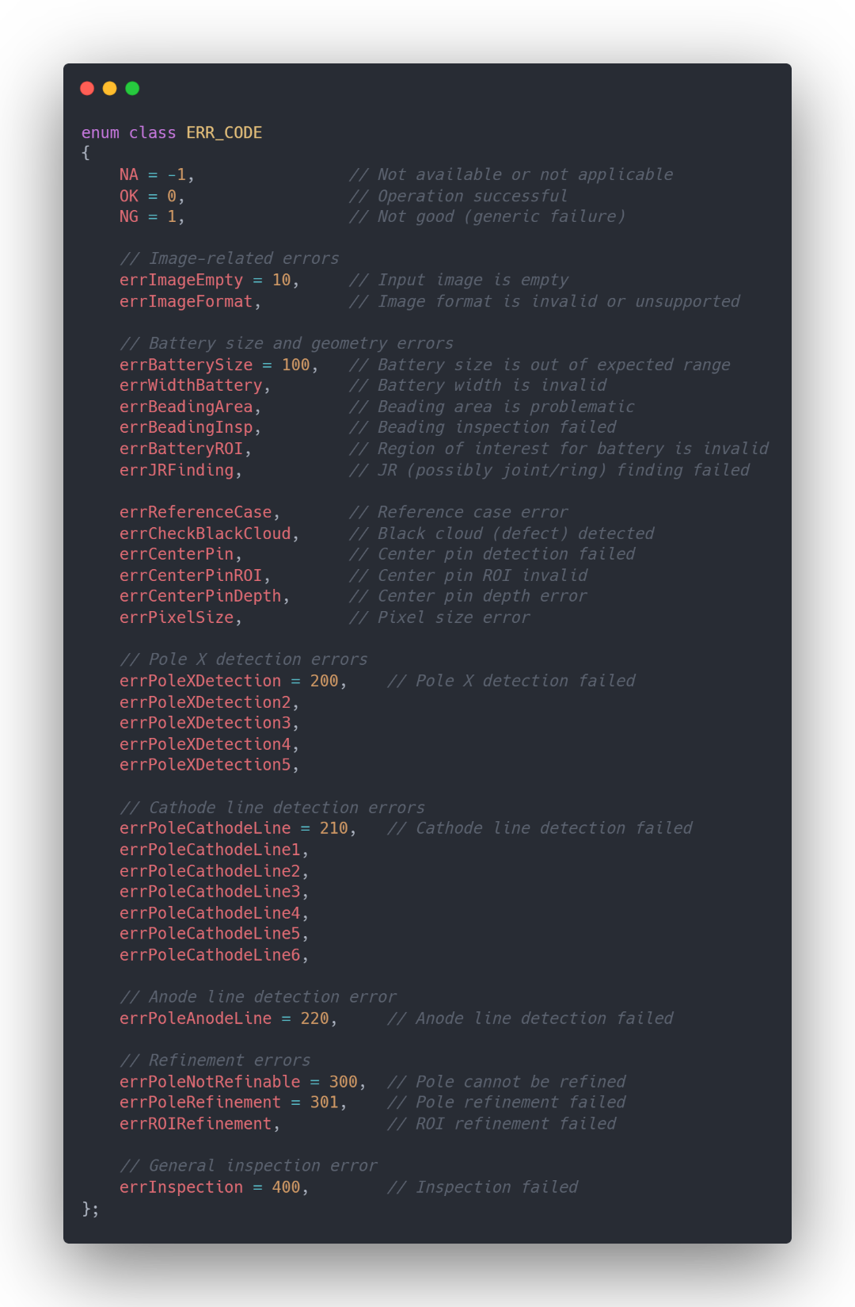
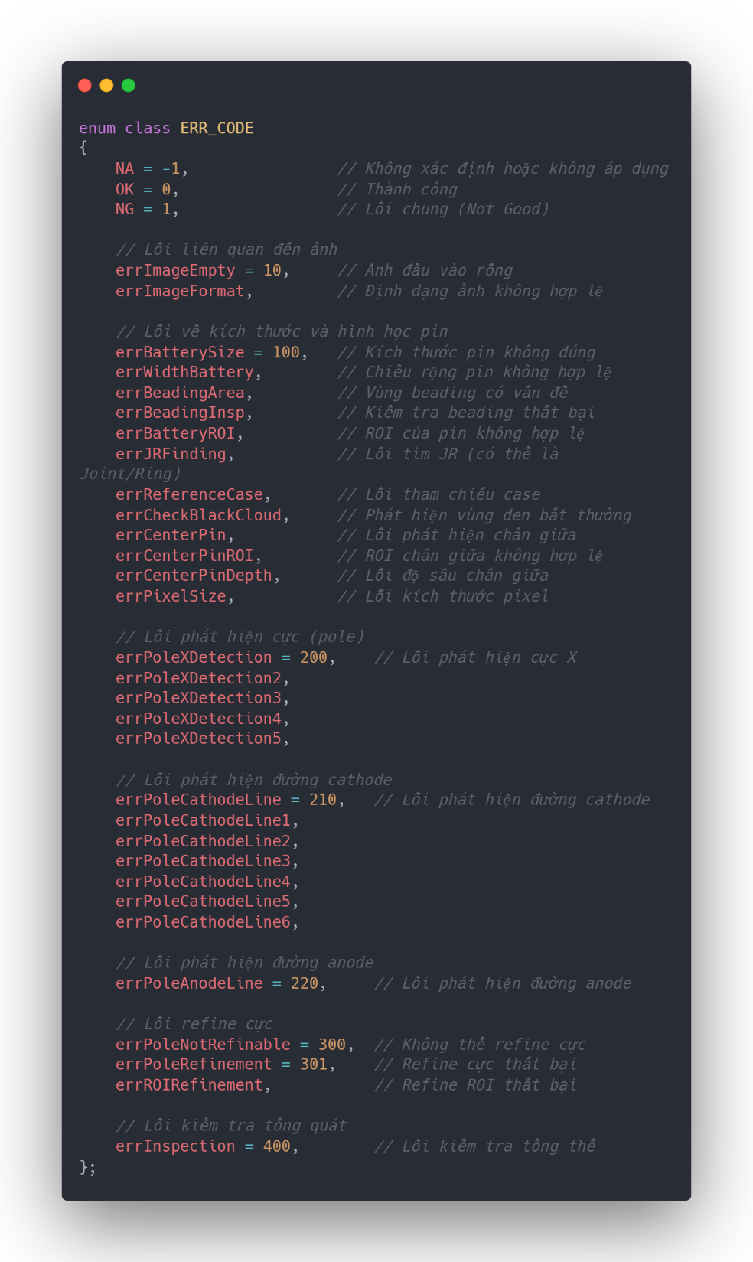

Slide 27



Nếu selectROI có tọa độ (x, y) và kích thước (width, height), thì: br (bottom right)

Slide 28


